Slide 1
Web Scraping WhaleWisdom
NYCDSA Web Scraping Project
Jose Gonzalez

Slide 2
Is there correlation between institutional investor buying and stock returns in Anaplan (NYSE:PLAN)?
Potentially interested parties
Other investors looking to increase returns based on competition behavior
Purpose of the project
Understand if web scraping 13F data is useful for stock investors
Questions
Does institutional buying correlate with positive returns?
Does institutional selling correlate with negative returns?
Is the type of shareholder/institution important to the shareholder base?
What type of institutions help predict returns or are useful to be invest alongside for certain styles (ex. VCs for long-term investors)

Slide 3
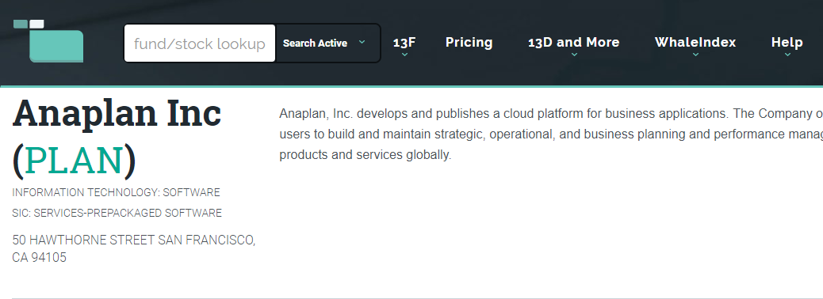
Web Scraping WhaleWisdom with Selenium
Obtaining the XPATH from the first row in the tables and creating a loop that iterates over every row.
Creating a function that clicks the next button to help scrape all the subsequent pages and each row from the table.

Slide 4
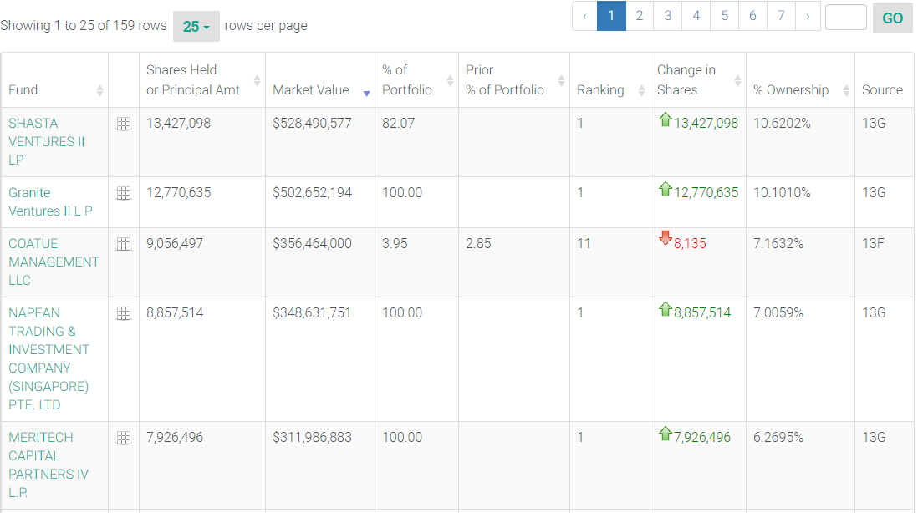
158 filers were included in this dataset, including institutions ranging from large asset managers of ETF indexes, hedge funds, venture capital firms, and even corporations like Salesforce.
The highest concentration on a portfolio level seems to be from venture capital funds like Shasta Ventures

Slide 5
If I was able to scrape the data
I would have created visualizations of the types of firms that were involved as shareholders of Anaplan.
I would have tried to come up with the profile of the “average” Anaplan shareholder.
I would have tried to see if institutional buying or selling correlated with positive or negative stock returns.
After trying to assess correlation I would have tried to split the institutions into types based on similarities, to see if venture capital firms, hedge funds, or asset managers had predictive power vs. another group of institutional investors
I would have also tried to understand when selling was for economic and non-economic reasons, as I think that would be a huge confounding factor in the dataset that would obscure a lot of the potential insights

Slide 6
Conclusion
Since I could not accurately scrape data from the website into a csv file I was unable to perform a proper data analysis.
Even from just glancing at the dataset there were a lot of interesting questions that could have been attempted to be answered.
There is definitely a use for other investors to mine this type of data to try to understand things like sentiment and shareholder base, and it is potentially correlated with securities prices.
I cannot conclude institutional buying or selling positively or negatively affects the returns of Anaplan stock

